Slide 1
Heat recovery for an efficient microwave process
Slag Valorisation Symposium
Dr. Ir. Willem Deleu

Slide 2
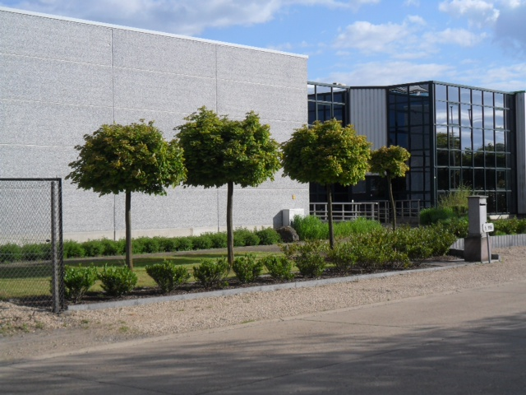
Microwave Energy Applications Management
An all-in solution provider for industrial microwave technology applications
SME, engineering company, in Herk-de-Stad, Belgium
Collaboration with relevant university departments in Belgium
Dedicated test & application center
Proven track record, solid references
Global player

Slide 3
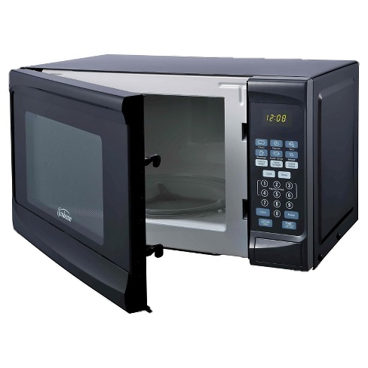
Why microwaves ?
Fast energy transfer
Efficient energy transfer
Uses electric energy

Slide 4
microwave basics
MICROWAVE
dielectric properties
penetration depth
mono/multi mode
HEAT TRANSFER
conduction
convection
radiation
AMBIENT CONDITIONS
environment gas
(air, nitrogen, oxygen)
pressure
(vacuum, 1 bar, high pressure)
MW HEATING PROCESS
CHEMICAL REACTIONs
exothermic reaction
endothermic reaction
MASS TRANSFER
evaporation
A microwave heating process is complex but not more so than other heating processes!!!

Slide 5
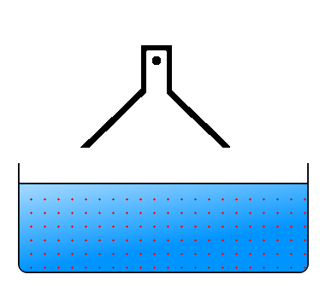
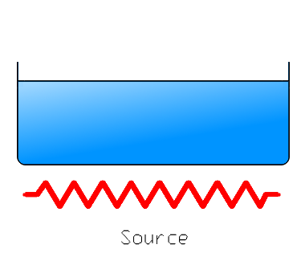
Microwave vs other energy transfer technology
CLASSICAL HEATING
MICROWAVE HEATING
External heating source
Surface energy transfer
Efficiency 20-40%
Tcore ≤ Tdesired << Tsurf
Product is heat source
Volumetric energy transfer
Efficiency 80-100%
Tproduct = Tdesired
ΔT
ΔT

Slide 6
Microwave basics
Classical Drying
Microwave Drying
Slow, retardation
Drying from the surface to the core
Moisture and temperature gradients
High surface area of product needed
Quick, no retardation
Drying from the core to the surface
Limited moisture and temperature gradients
Volume of product needed

Slide 7
Types of microwave dryers
1st generation: microwave heating
Only heating through MW
Cold air in oven
2th generation: hybrid heating
Magnetron & transformer heat blown in oven
3th generation: hybrid + heat recovery
Preheating incoming product by outgoing product air
Efficiency = 0.9 * 0.7 = 63 %
= transformer * magnetron efficiency¹
Efficiency = 63% + 37%
Efficiency ≥ 100%
¹Magnetron efficiency = 70% for 2450 MHz

Slide 8
Microwave History
COLD AIR
3th generation
2th generation
1st generation
Transformer & magnetron
HOT AIR
MW
HOT & MOIST AIR

Slide 9
Case study: slag drying
Energy to heat slag to 1200°C
± 400 kWh / ton
Energy to evaporate water:
± 719 kWh / ton
10 % moisture in slag
± 17% of energy needed for drying
20 % moisture in slag:
± 31% of energy needed for drying

Slide 10
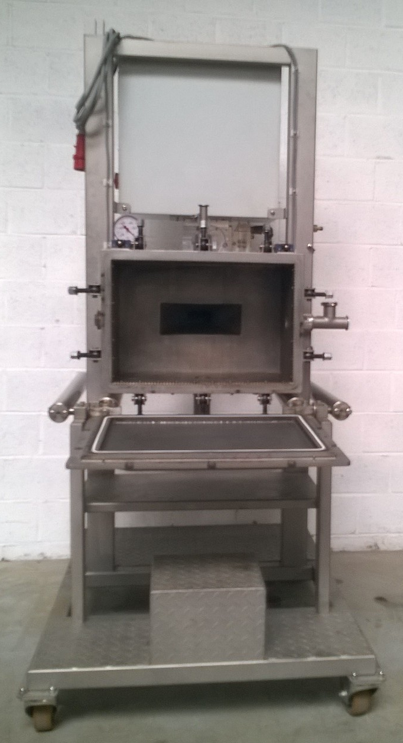
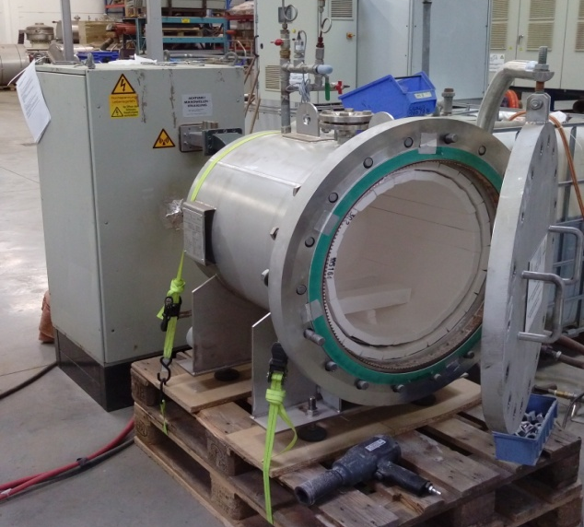
Case study: slag drying with 2nd gen.
Meam Explorer
1.2 kW Microwave power
Vacuum to 2 bar
MEAM High pressure
6 kW Microwave power
1200°C max
12 bar max pressure

Slide 11
Effect of airflow on drying speed

Slide 12
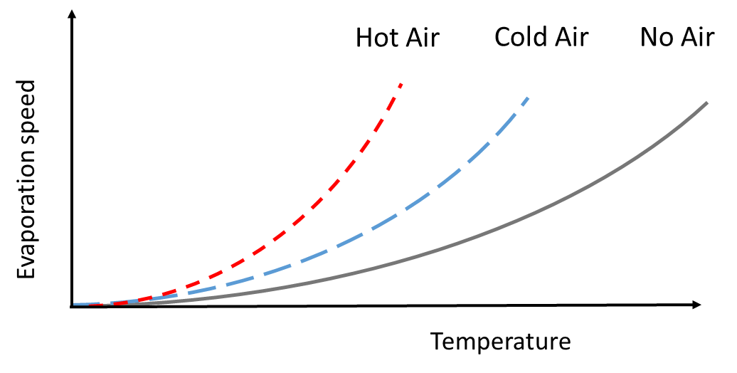
Drying speed and evaporative cooling

Slide 13
Fast + Low temperature drying (2nd gen.)
Low temperature
Fast drying
Lower radiative heat loss
Mild process conditions
Lower energy requirements
Lower radiative heat loss
Small machine (lower losses)
Fast startup/stop

Slide 14
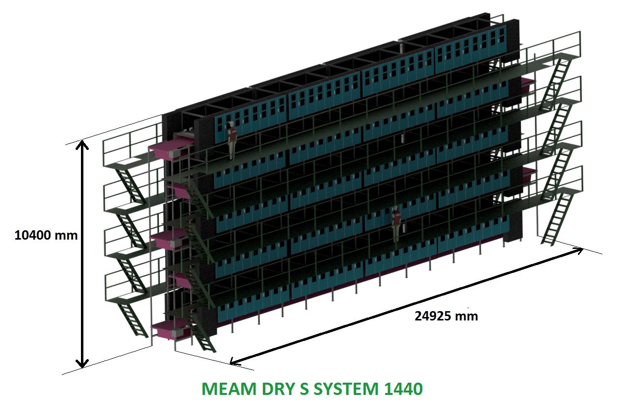
Concept drawing 20 ton/h 10% → 1%

Slide 15
Thank you for your attention!
Questions?

Slide 16
(Image courtesy of NASA)

Slide 17
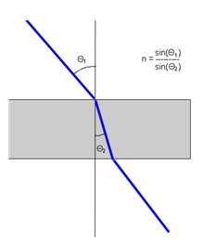
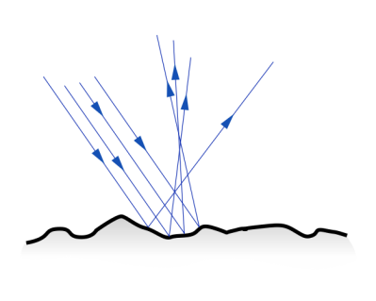
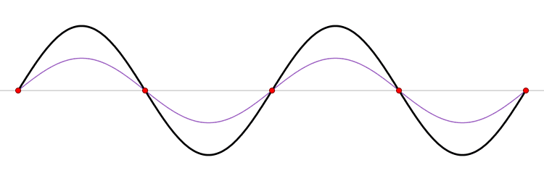
Microwave components & physics
Reflection
Transmission
Absorption
Standing waves

Slide 18
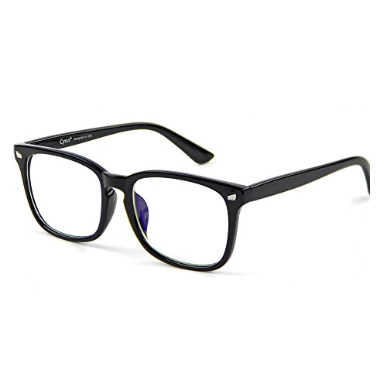
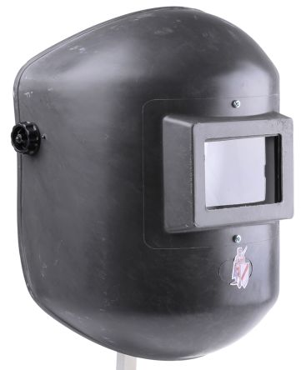
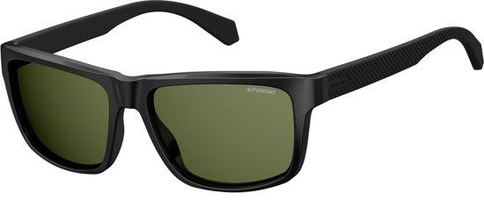
Loss factor: absorption of MW
Low loss factor
- Silicates
- Gasses
- Alumina
…
Medium loss factor
High loss factor
- Metallic particles
- Carbon
- Magnetic solids
- Water
….

Slide 19
Microwave components & physics
Frequency (Hz)
0,915 GHz
2,45 GHz
5,8 GHz
Electric field (V/m)
Cavity specific
Depends on magnetron
$$P_{in}=2.π.f.ε_{0}.ε_{2}.E_{loc}^{2}$$
Absorbed power (W/m³)
Dielectric loss factor
Material specific
Temperature dependant

Slide 20
Microwave components & physics
Absorbed power (W/m³)
Energy loss:
Evaporation
Convection + conduction + radiation
Endothermic reaction
$$\frac{∆T}{t}=\frac{P_{in} −P_{out}}{ρ.Cp}$$
Density (kg/m³)
Heat capacity (J/kg.°C)

